Slide 1
WikiMSK
A new tool for Musculoskeletal Medicine training
Notes:
https://www.jmir.org/2015/2/e48/pdf

Slide 2
“...and if they wish to learn medicine, I will teach them without pay or commitment”
— Hippocratic Oath, 4th century BC

Slide 3
Disclaimers
I, Jeremy Steinberg, the founder and leader editor have no conflicts of interest to declare.
The server space has been donated by Ellerslie Medical Centre, 42 Robert Street, Auckland.
There is no advertising or links to any non-NZAMM entities.

Slide 4
My IT Background
}
Skill level
Started 5 years ago. Main projects:
jackofallorgans.com (wordpress), various clinical calculators – 30,000 views a month
ellersliemedical.co.nz (wordpress), a lot of custom code – 8,000 views a month
Wedding website, completely custom made, using Jekyll
Built coding projects for healthnavigator.org.nz
HTML
CSS
Javascript
PHP
Sys Admin
Java
Python

Slide 5
Acknowledgements
Sitehost (Hosting provider) – has answered a lot of stupid questions
Gareth Fletcher (IT Architect) – helped with linux stuff
Gideon Steinberg (Software Developer) – general software development help

Slide 6
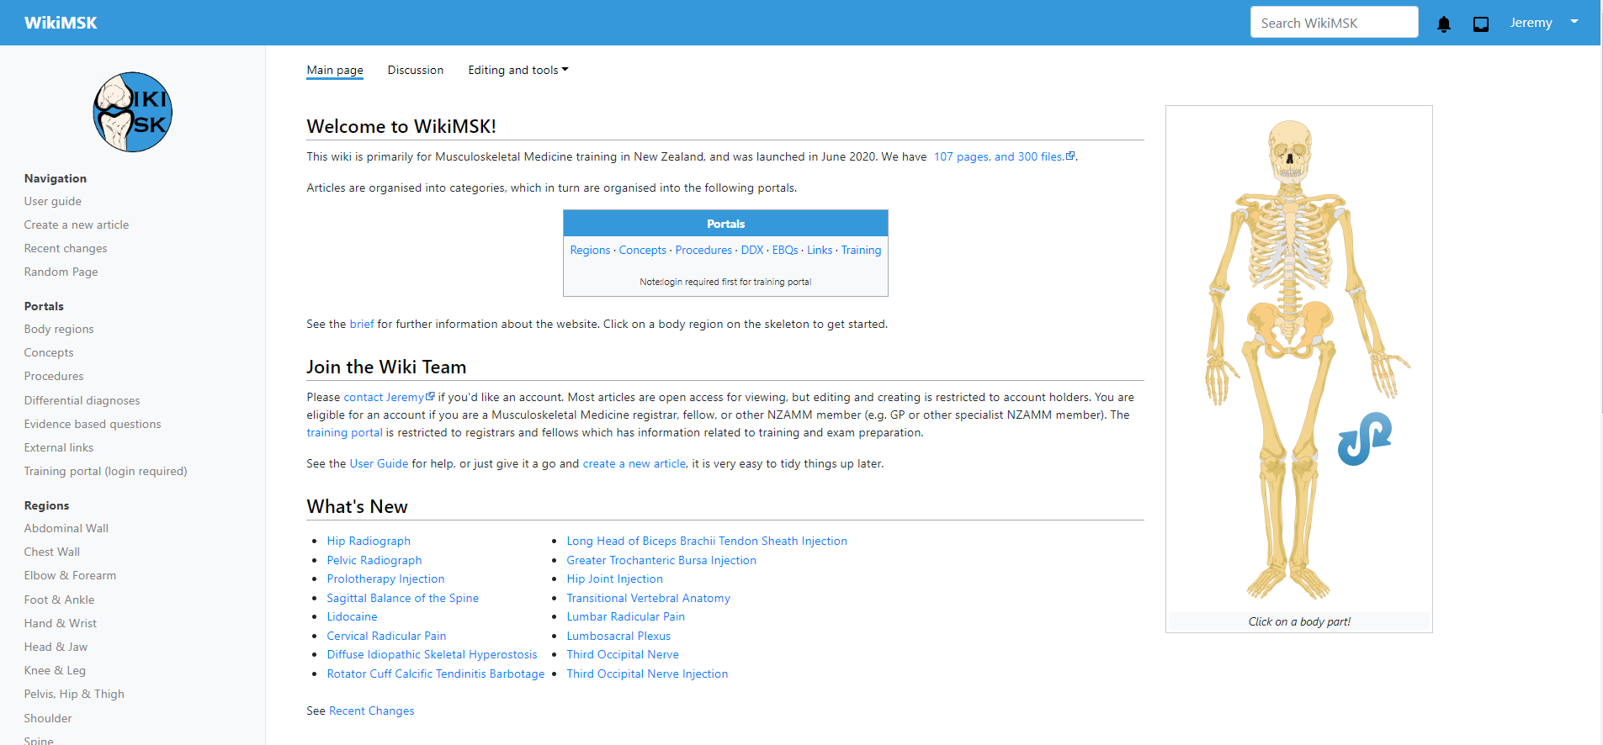
wikimsk.org

Slide 7
Mission
Produce an accurate, readable, reliable, accessible, and up-to-date repository of knowledge for the practice of Musculoskeletal Medicine in New Zealand.

Slide 8
Choosing a Wiki - Pros and Cons
Advantages | Disadvantages
Knowledge Construction | Setup and Preparation
Collaborative Learning | Acceptability and Engagement
Social Learning | Challenges to Collaboration
Engagement and Ownership | Need for Oversight
Peer Feedback | Issues relating to Hierarchy
Administrative Benefits | -

Slide 9
Relevant English Wikis

Slide 10
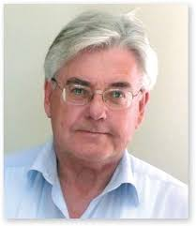
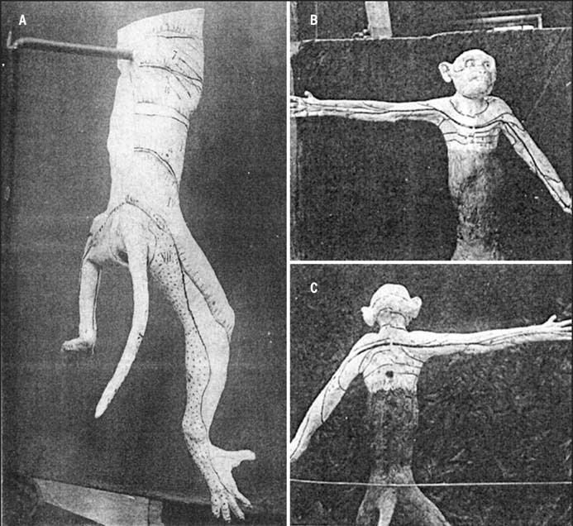
©
All rights reserved
Some rights reserved
No rights reserved
(copyright is dead)

Slide 12
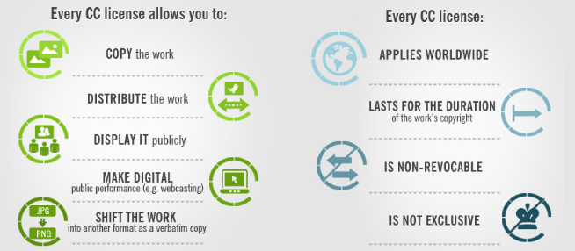
https://foter.com/blog/how-to-attribute-creative-commons-photos/

Slide 13
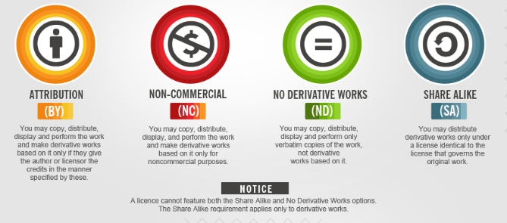
https://foter.com/blog/how-to-attribute-creative-commons-photos/

Slide 14
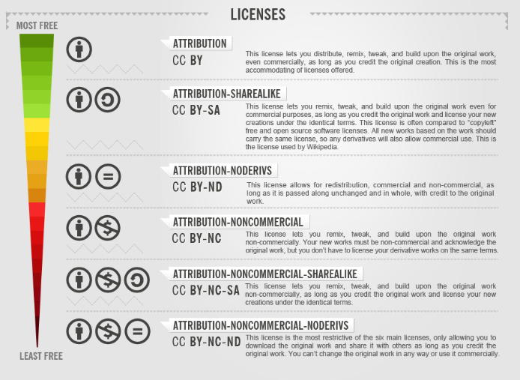
https://foter.com/blog/how-to-attribute-creative-commons-photos/

Slide 15
≈

Slide 16
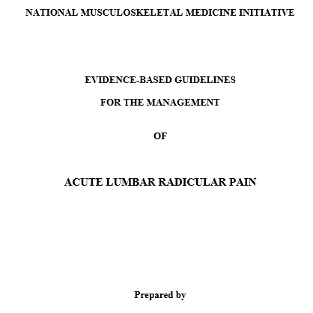
©
Notes:
The AccessControl extension allows restricting access to specific pages based on internal groups or group lists from user space.
MediaWiki in its default state is not designed as a Content Management System (CMS), but when used as a corporate or school intranet it is required to protect sensitive data. AccessControl has been developed for this purpose.

Slide 17
Infrastructure
Ellerslie Medical Centre servers, hosted by sitehost.nz
Daily backups by sitehost.nz, including offsite copies
Three websites on server (ellersliemedical.co.nz and jackofallorgans.com), total cost of $80 a month, kindly donated by Ellerslie Medical Centre.
~15GB capacity, current website size is 500Mb

Slide 18
Software
All latest stable most secure software versions

Slide 19
Features
Easy navigation and search
Editing, formatting, embed videos and images, referencing
File uploading
User management and access control
Versatile and extremely customisable, limited only by programming knowledge
Notification system
Diagramming and Algorithm software
Quiz software

Slide 20
Access Control
Status | Read CC Content | Create and Edit | Training Portal Access | Certify Articles | Website Administration
Non-member
Member
Registrar
Fellow
Lead Editor

Slide 21
Ease of Use
Variable, similar to wikipedia
Reading and navigating is easy
Very basic editing is easy
Other stuff has a learning curve
I’m happy to teach one on one

Slide 22
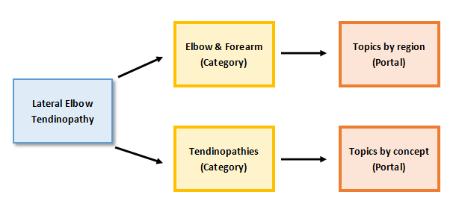
Structure

Slide 23
Portals

Slide 24
Quality Control
◔ Stub. Partial information only
◒ Partial. Basic structure and information
◕ Complete. But not signed off.
⬤ Certified. Signed off by a fellow

Slide 25
Future Directions
Case History System
Optional core module for training
Development of an Android and iOS mobile app (may require outsourcing)
For any tricky development requirements contract an experienced MediaWiki developer.
May eventually need migration to a dedicated server, cost ~$30 a month.

